Slide 1
Introduction to Visual Studio and Visual Programming
Chapter 2 of Visual C# How to Program, 6/e

Slide 2
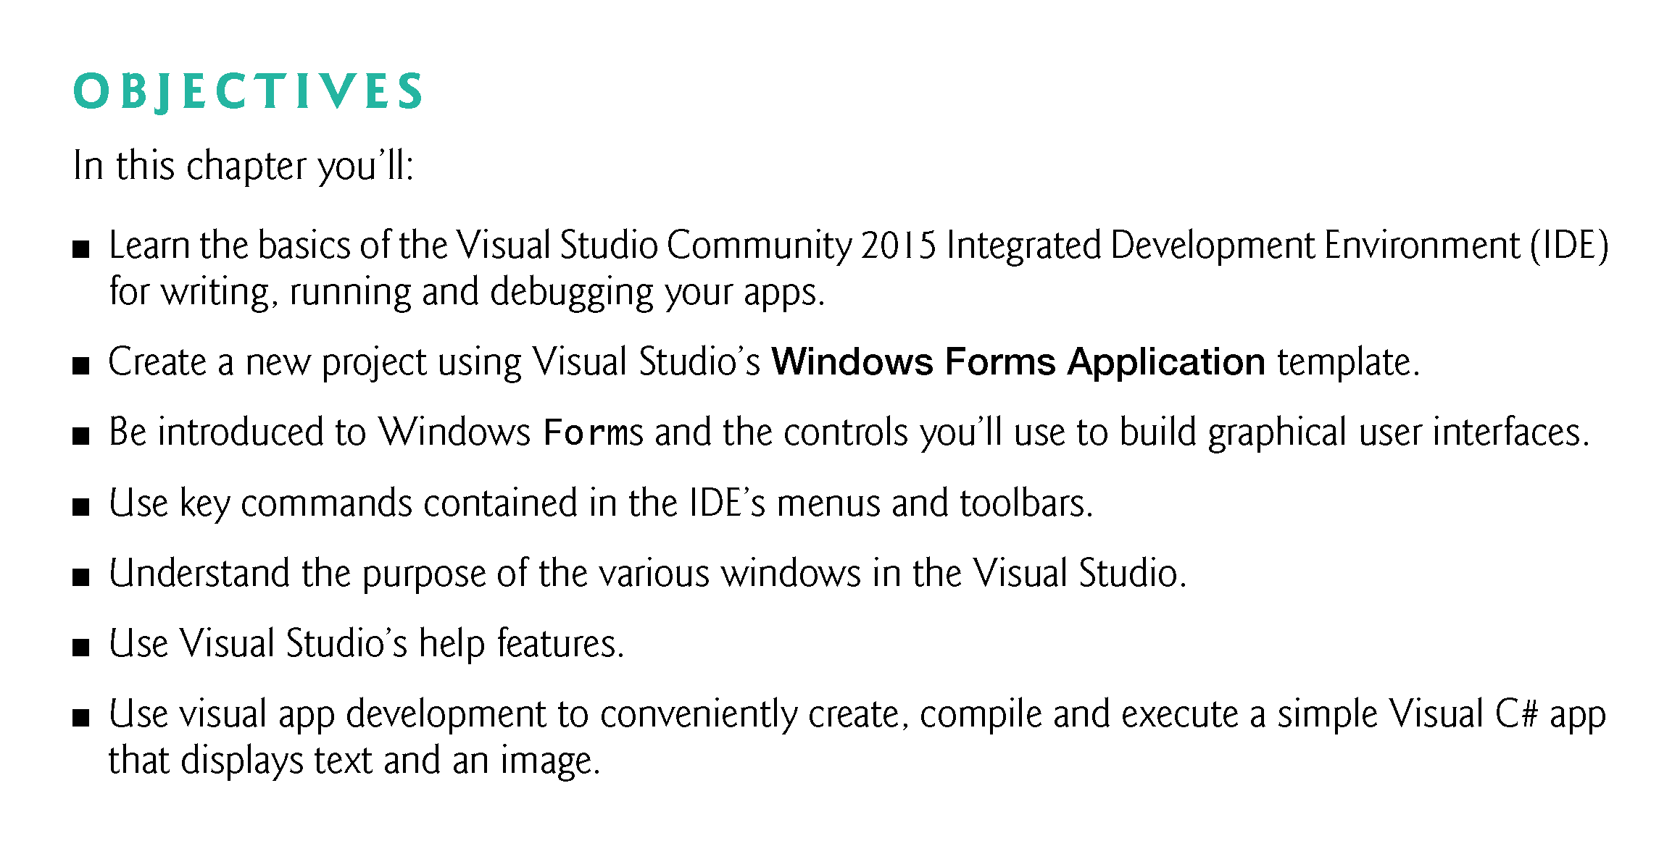

Slide 3
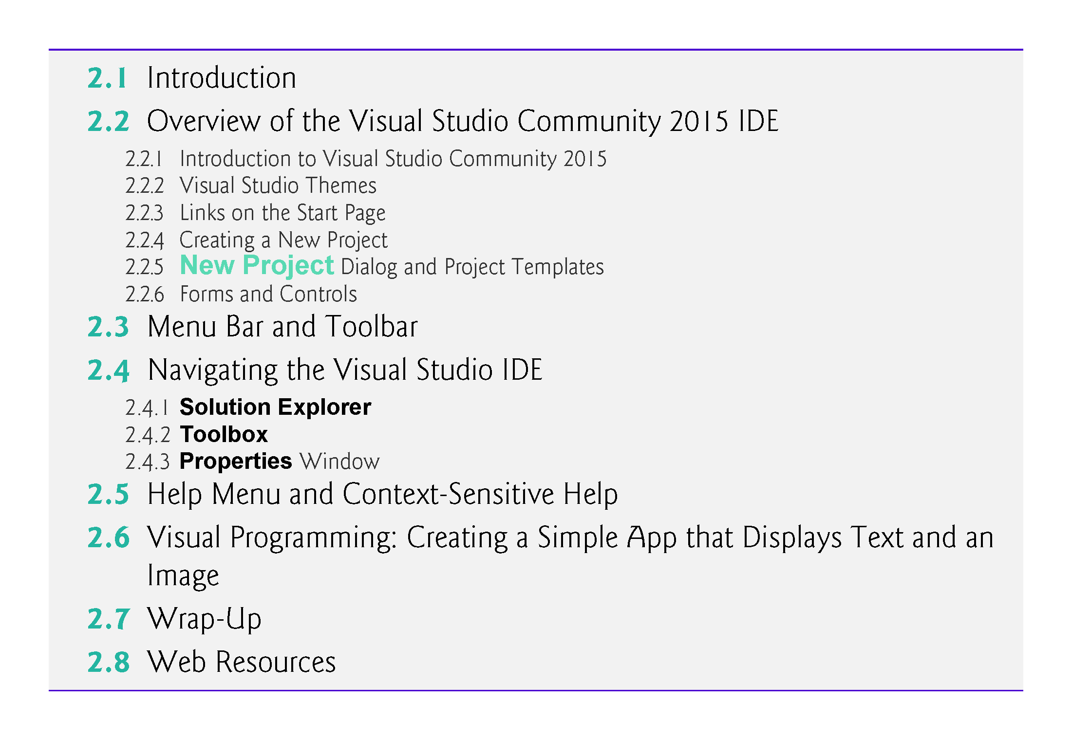

Slide 4
2.1 Introduction
Visual Studio is Microsoft’s Integrated Development Environment (IDE) for creating, running and debugging apps (also called applications) written in C# and various other .NET programming languages.
In this chapter, we overview the Visual Studio Community 2015 IDE, then show how to create a simple Visual C# app by dragging and dropping predefined building blocks into place—a technique known as visual app development.

Slide 5
2.2 Overview of the Visual Studio Community 2015 IDE
This book’s examples, screen captures and discussions are based on the free Visual Studio Community 2015 running on Windows 10.
The examples will work on full versions of Visual Studio as well—though some options, menus and instructions might differ.
From this point forward, we’ll refer to Visual Studio Community 2015 simply as “Visual Studio” or “the IDE.” We assume that you have some familiarity with Windows.

Slide 6
2.2.1 Introduction to Visual Studio Community 2015
When you open Visual Studio it initially displays the Start Page (Fig. 2.1).
Depending on your version of Visual Studio, your Start Page may look different.
The Start Page contains a list of links to Visual Studio resources and web-based resources.
At any time, you can return to the Start Page by selecting View > Start Page.

Slide 7
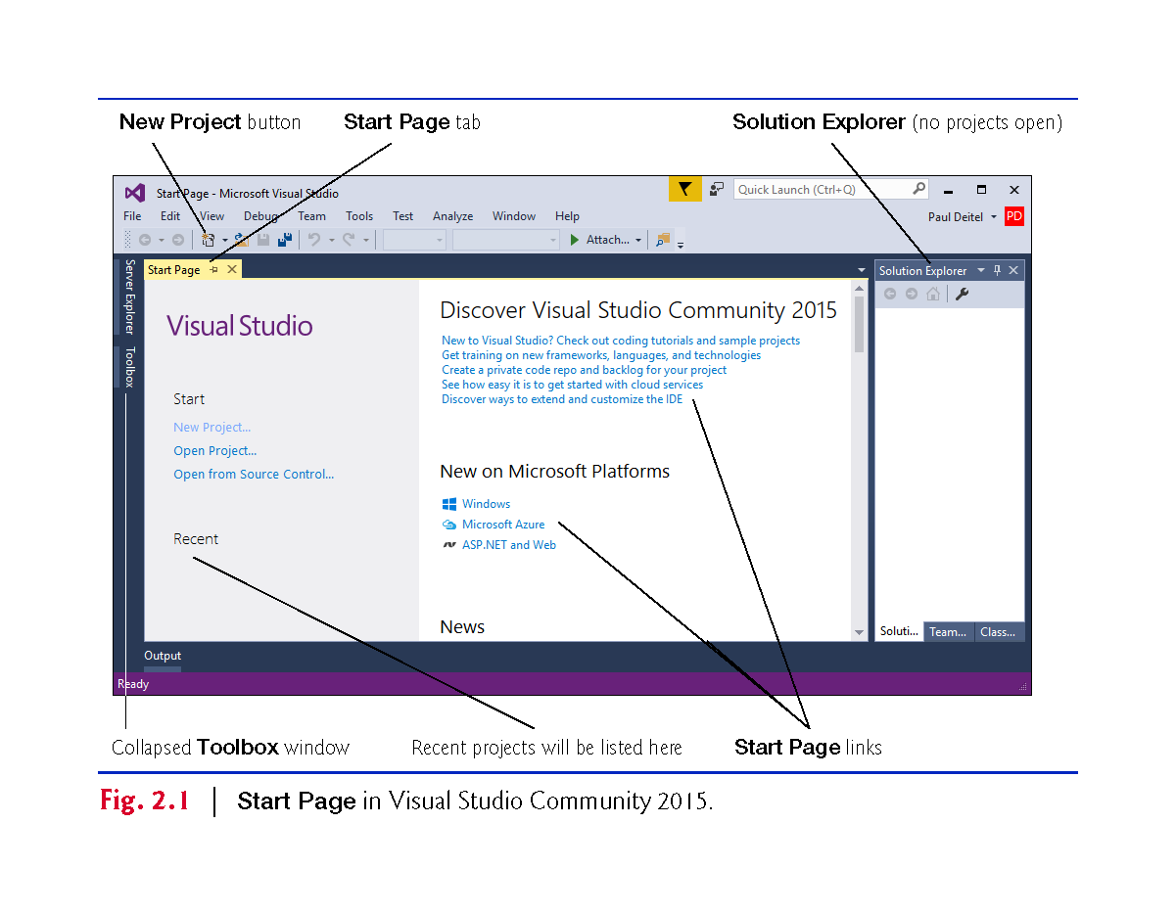

Slide 8
2.2.2 Visual Studio Themes
Visual Studio supports three themes that specify the IDE’s color scheme:
a dark theme (with dark window backgrounds and light text)
a light theme (with light window backgrounds and dark text) and
a blue theme (with light window backgrounds and dark text).
We use the blue theme throughout this book.
The Before You Begin section after the Preface explains how to set this option.

Slide 9
2.2.3 Links on the Start Page
The Start Page links are organized into two columns.
The left column’s Start section contains options for building new apps or working on existing ones.
The left column’s Recent section contains links to projects you’ve recently created or modified.

Slide 10
2.2.3 Links on the Start Page
The Start Page’s right column contains links to various online documentation and resources to help you get started with Visual Studio and learn about Microsoft programming technologies.
To access more extensive information on Visual Studio, you can browse the MSDN (Microsoft Developer Network) Library at
https://msdn.microsoft.com/library/dd831853
You also can browse the web from the IDE by selecting View > Other Windows > Web Browser.
To request a web page, type its URL into the location bar (Fig. 2.2) and press Enter

Slide 11
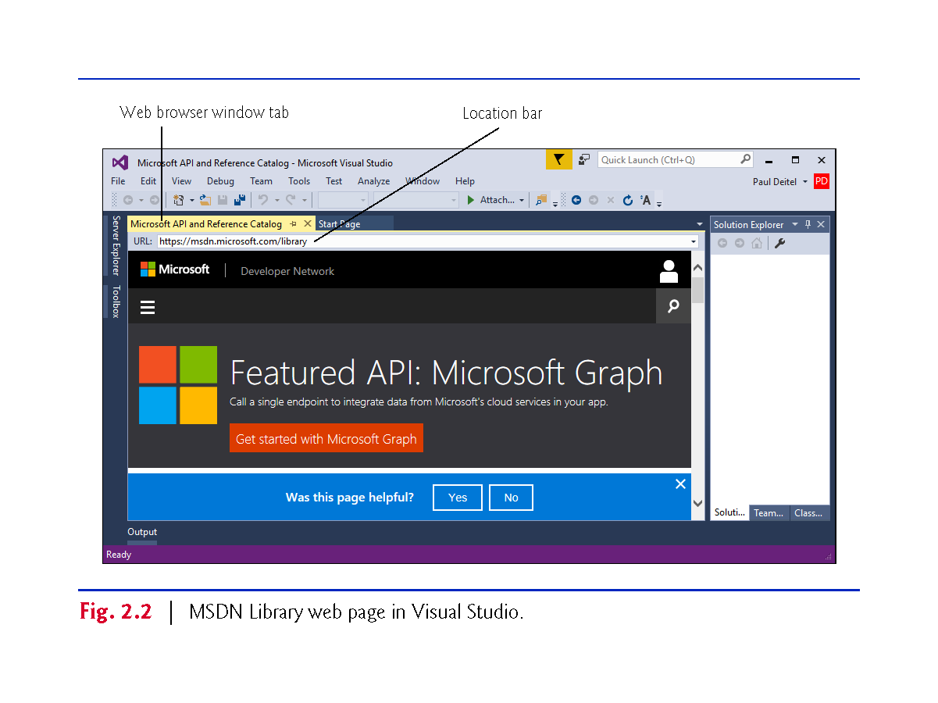

Slide 12
2.2.4 Creating a New Project
A project is a group of related files, such as the Visual C# code and any images that might make up an app.
Visual Studio organizes apps into projects and solutions, which contain one or more projects.
Multiple-project solutions are used to create large-scale apps.
You select File > New > Project… to create a new project or File > Open > Project/Solution… to open an existing one.
You also can click the corresponding links in the Start Page’s Start section.

Slide 13
2.2.5 New Project Dialog and Project Templates
For the discussions in the next several sections, we’ll create a new project. Select File > New > Project… to display the New Project dialog (Fig. 2.3).
Dialogs are windows that facilitate user–computer communication.

Slide 14
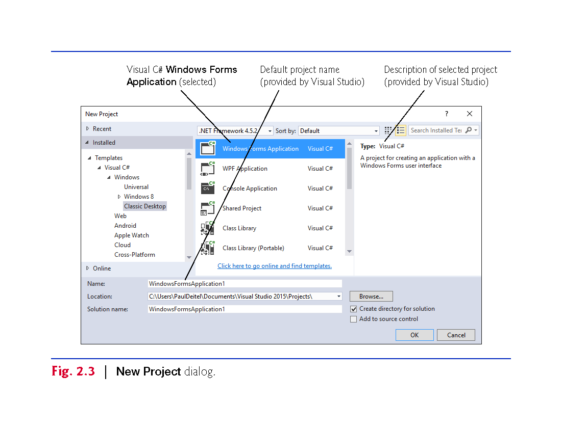

Slide 15
2.2.5 New Project Dialog and Project Templates
Visual Studio provides many templates—the project types that users can create in Visual C# and other languages.
A Windows Forms Application is an app that executes within a Windows operating system and typically has a graphical user interface (GUI).
Users interact with this visual part of the app.
To create a Windows Forms Application, under Templates select Visual C# > Windows > Classic Desktop, then in the middle column select Windows Forms Application.
Click OK to display the IDE in Design view (Fig. 2.4), which contains the features that enable you to create an app’s GUI.

Slide 16
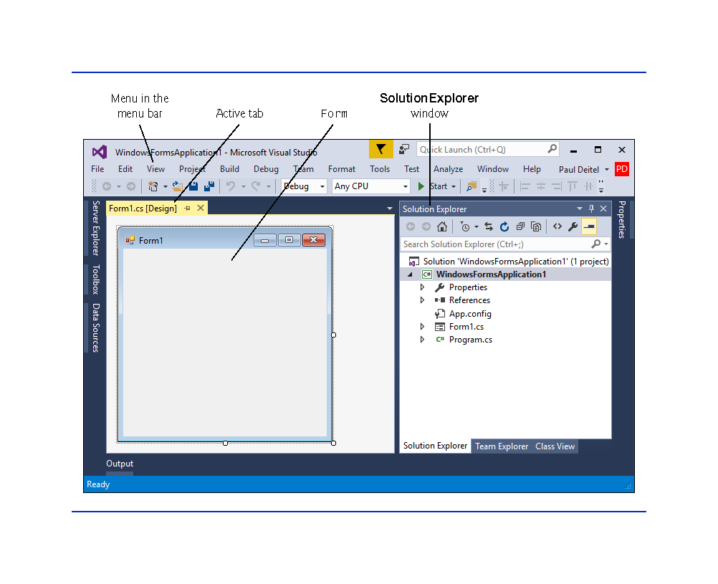

Slide 17
2.2.6 Forms and Controls
The rectangle in the Design area titled Form1 (called a Form) represents the main window of the Windows Forms app.
Each Form is an object of class Form in the .NET Framework Class Library.
Apps can have multiple Forms (windows).
A Label typically contains descriptive text (for example, "Welcome to Visual C#!"), and a PictureBox displays an image.
Visual Studio has many preexisting controls and other components you can use to build and customize your apps.
Collectively, the Form and controls make up the app’s GUI.

Slide 18
2.2.6 Forms and Controls
Each open document’s name is listed on a tab. To view a document when multiple documents are open, click its tab.
The active tab (the tab of the currently displayed document) is highlighted.
The active tab’s highlight color depends on the Visual Studio theme—the blue theme uses a yellow highlight and the light and dark themes use a blue highlight.

Slide 19
2.3 Menu Bar and Toolbar
Commands for managing the IDE and for developing, maintaining and executing apps are contained in menus, which are located on the menu bar of the IDE (Fig. 2.5).
The set of menus displayed depends on what you’re currently doing in the IDE.
Menus contain groups of related commands called menu items that, when selected, cause the IDE to perform specific actions.
The menus depicted in Fig. 2.5 are summarized in Fig. 2.6.

Slide 20
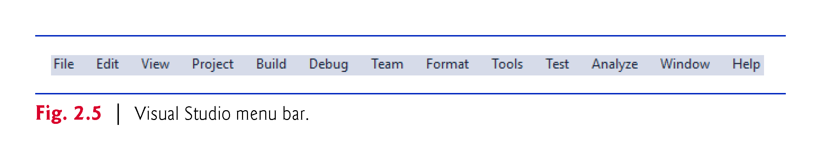

Slide 21
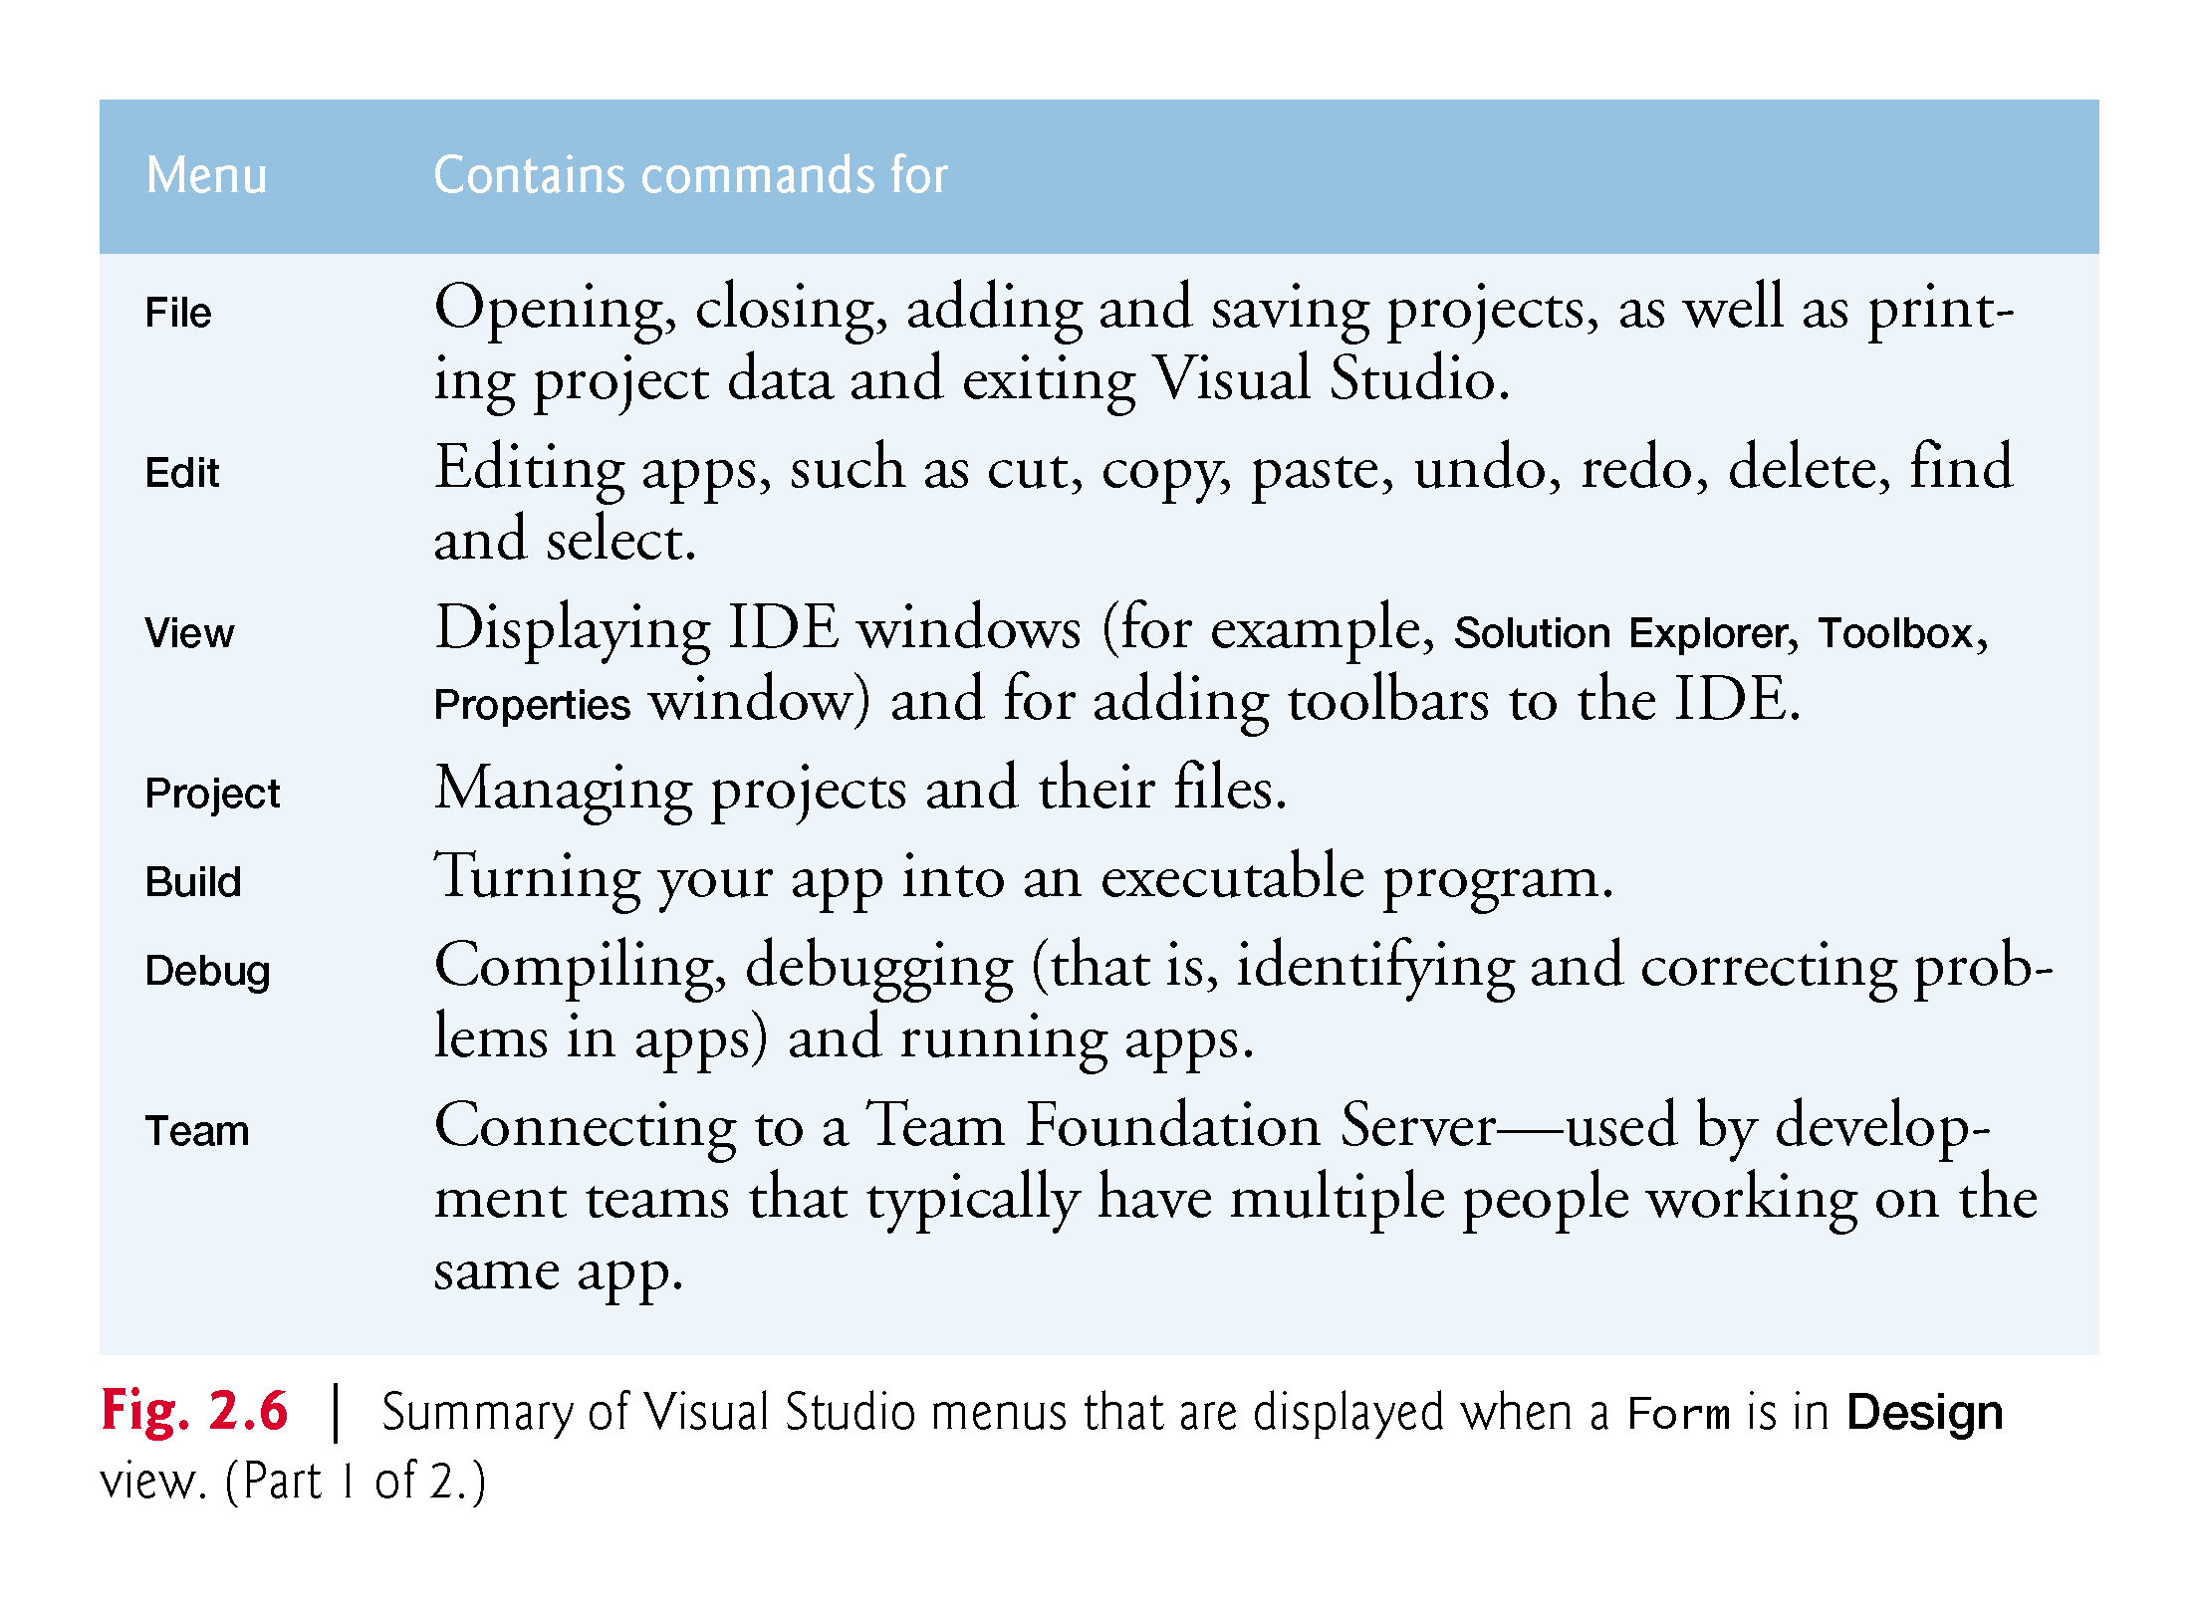

Slide 22
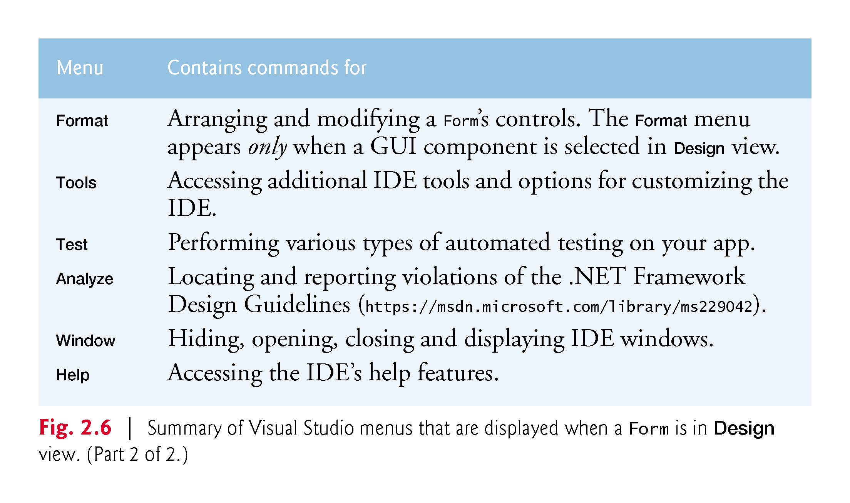

Slide 23
2.3 Menu Bar and Toolbar
You can access many common menu commands from the toolbar (Fig. 2.7), which contains icons that graphically represent commands.
By default, the standard toolbar is displayed when you run Visual Studio for the first time—it contains icons for the most commonly used commands, such as opening a file, saving files and running apps.
The icons that appear on the standard toolbar may vary, depending on the version of Visual Studio you’re using.

Slide 24
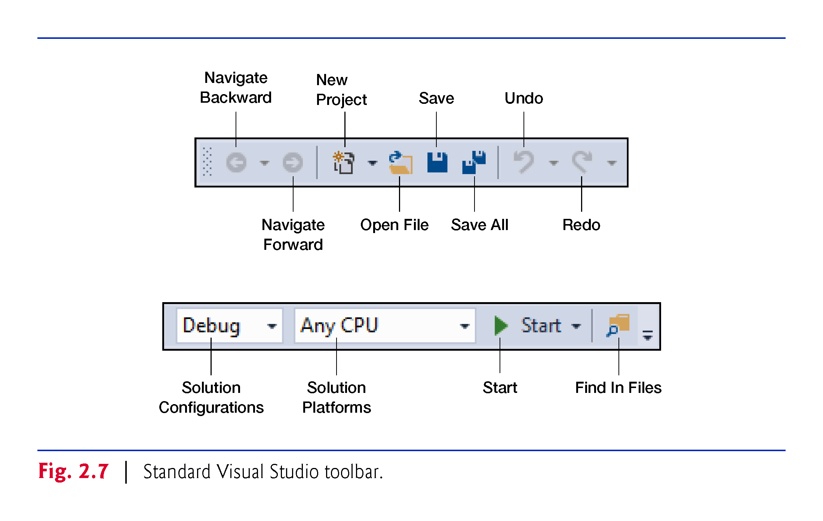

Slide 25
2.3 Menu Bar and Toolbar
You can customize which toolbars are displayed by selecting View > Toolbars then selecting a toolbar from the list in Fig. 2.8.
Each toolbar you select is displayed with the other toolbars at the top of the Visual Studio window.
You move a toolbar by dragging its handle
To execute a command via the toolbar, click its icon.
Hovering the mouse pointer over an icon highlights it and displays a description of the icon called a tool tip (Fig. 2.9)

Slide 26
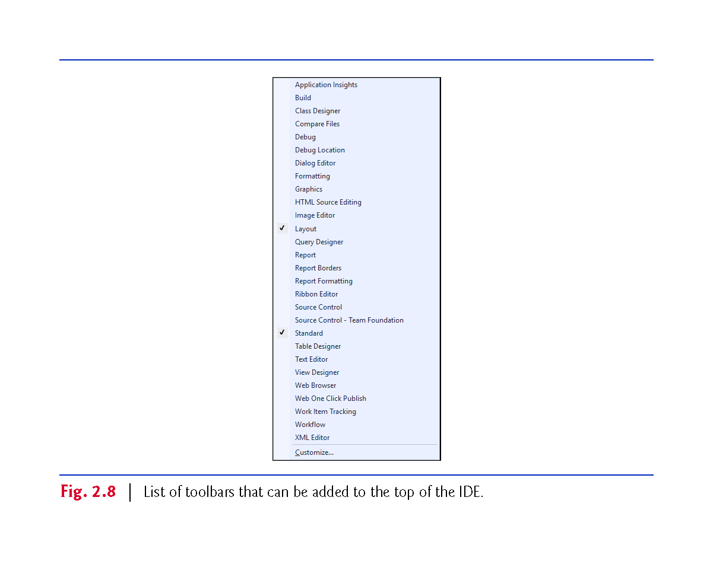

Slide 27
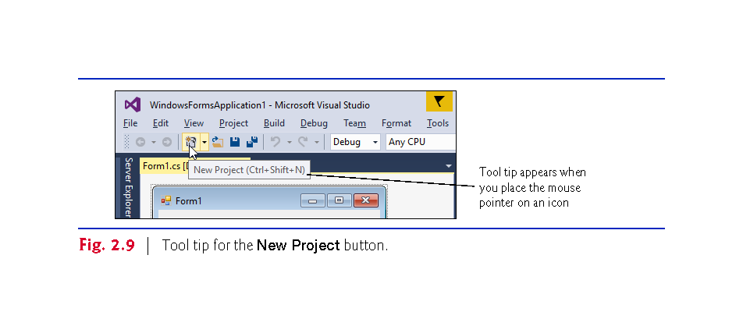

Slide 28
2.4 Navigating the Visual Studio IDE
The IDE provides windows for accessing project files and customizing controls. Each can be accessed by selecting its name in the View menu.
Visual Studio provides an auto-hide space-saving feature.
When auto-hide is enabled for a window, a tab containing the window’s name appears along the IDE window’s left, right or bottom edge (Fig. 2.10).
Clicking the name of an auto-hidden window displays that window (Fig. 2.11).
Clicking the name again (or clicking outside) hides the window.
To “pin down” a window (that is, to disable auto-hide and keep the window open), click the pin icon.
When auto-hide is enabled, the pin icon is horizontal
When a window is “pinned down,” the pin icon is vertical

Slide 29
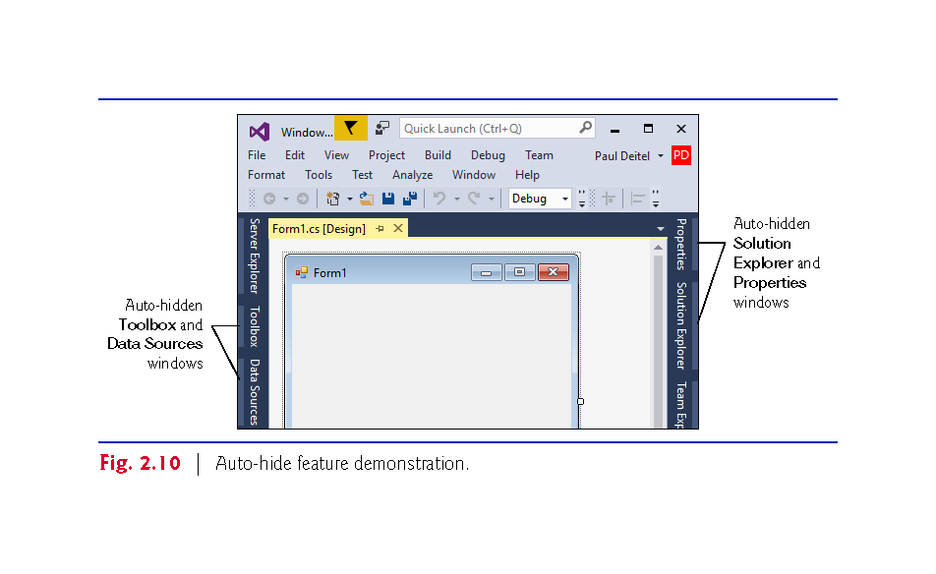

Slide 30
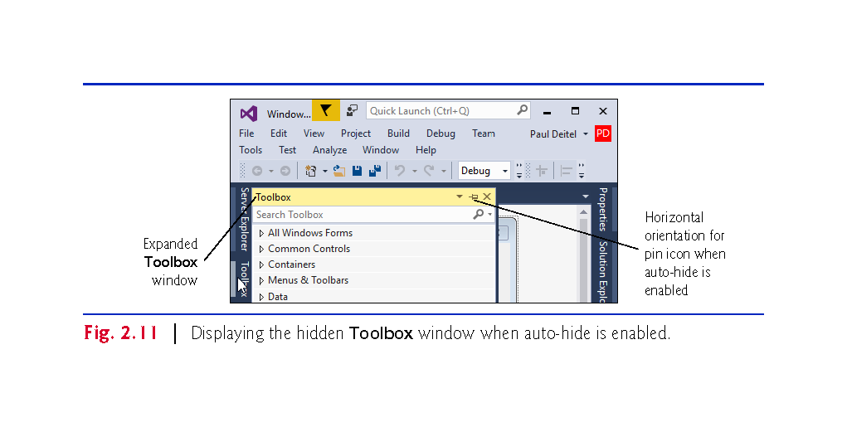

Slide 31
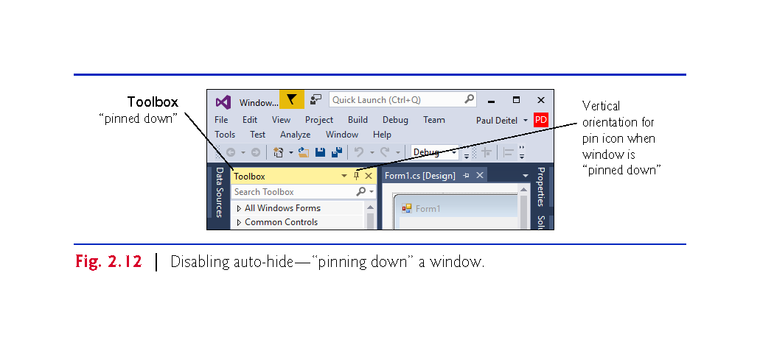

Slide 32
2.4.1 Solution Explorer
The Solution Explorer window (Fig. 2.13) provides access to all of a solution’s files.
If it’s not shown in the IDE, select View > Solution Explorer.
When you open a new or existing solution, the Solution Explorer displays the solution’s contents.

Slide 33
2.4.1 Solution Explorer
The solution’s startup project (shown in bold in the Solution Explorer) is the one that runs when you select Debug > Start Debugging (or press F5) or select Debug > Start Without Debugging (or press Ctrl + F5 key).
For a single-project solution, the startup project is the only project.
When you create an app for the first time, the Solution Explorer window appears as shown in Fig. 2.13.
The Visual C# file that corresponds to the Form shown in Fig. 2.4 is named Form1.cs (selected in Fig. 2.13).
Visual C# files use the .cs file-name extension, which is short for “C#.”

Slide 34
2.4.1 Solution Explorer
By default, the IDE displays only files that you may need to edit—other files that the IDE generates are hidden.
The Solution Explorer window includes a toolbar that contains several icons.
Clicking the Show All Files icon (Fig. 2.13) displays all the solution’s files, including those generated by the IDE.
Clicking the arrow to the left of a node expands or collapses that node.
Click the arrow to the left of References to display items grouped under that heading (Fig. 2.14).
Click the arrow again to collapse the tree.

Slide 35
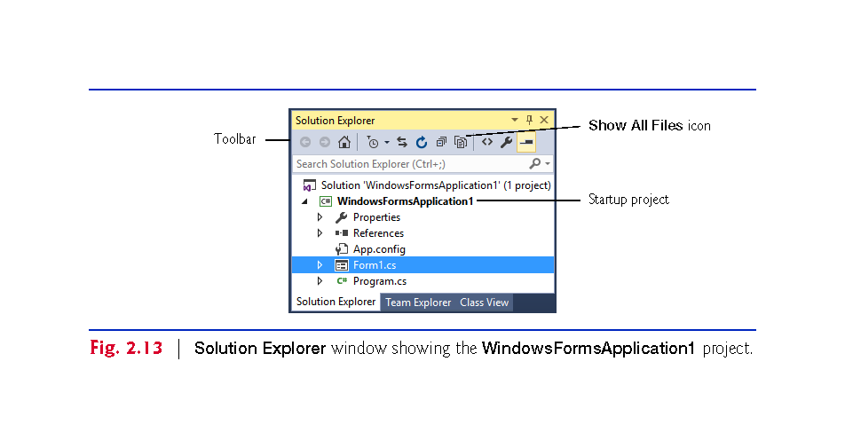

Slide 36
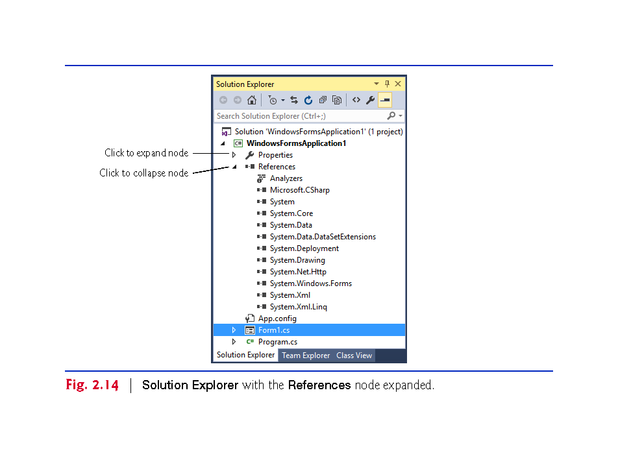

Slide 37
2.4.2 Toolbox
To display the Toolbox window, select View > Toolbox.
Contains the controls used to customize Forms (Fig. 2.15).
With visual app development, you can “drag and drop” controls onto the Form and the IDE will write the code that creates the controls for you.
The Toolbox groups the prebuilt controls into categories—All Windows Forms, Common Controls, Containers, Menus & Toolbars, Data, Components, Printing, Dialogs, Reporting, WPF Interoperability and General.

Slide 38
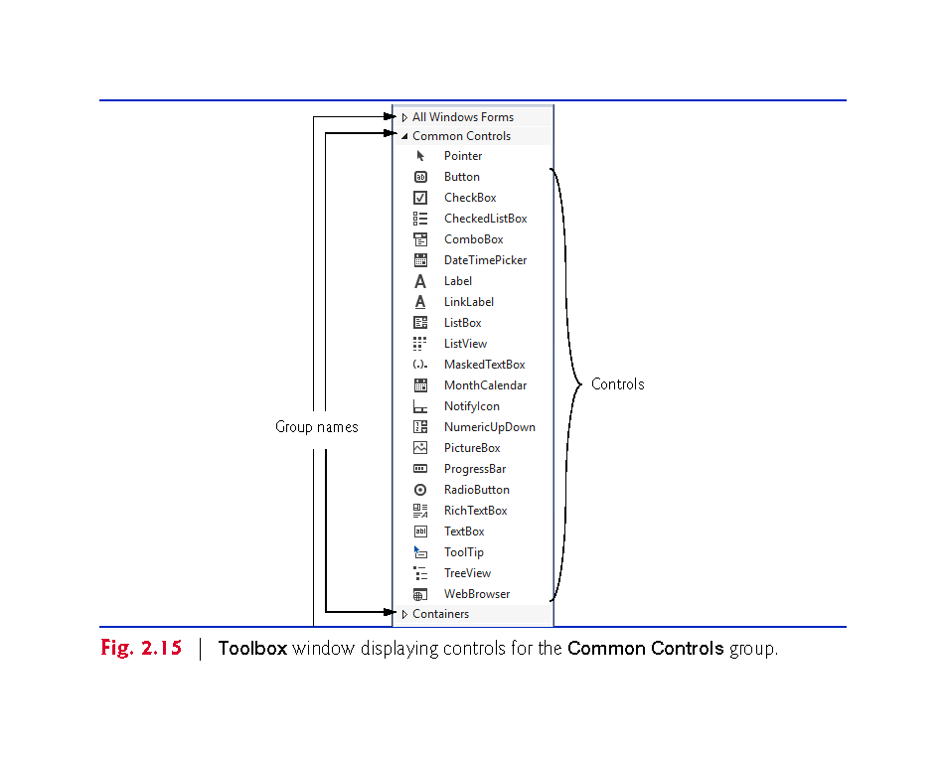

Slide 39
2.4.3 Properties Window
If the Properties window is not displayed below the Solution Explorer, select View > Properties Window to display it.
The Properties window contains the properties for the currently selected Form, control or file in the IDE.
Properties specify information about the Form or control.
When you select a property, its description is displayed at the bottom of the Properties window.

Slide 40
2.4.3 Properties Window
Fig. 2.16 shows Form1’s Properties window—you can view by clicking anywhere in the Form1.cs [Design] window.
The left column lists the Form’s properties
The right column displays the current value of each property.
You can sort the properties either
alphabetically (by clicking the Alphabetical icon) or
categorically (by clicking the Categorized icon).
The Properties window is crucial to visual app development.

Slide 41
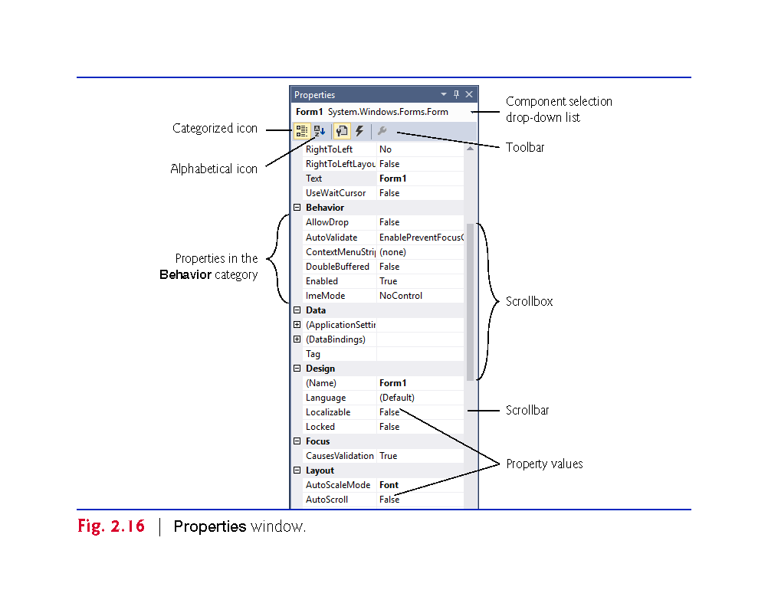

Slide 42
2.5 Help Menu and Context-Sensitive Help
Microsoft provides extensive help documentation via the Help menu, which is an excellent way to get information quickly about Visual Studio, Visual C# and more.
Visual Studio provides context-sensitive help pertaining to the “current content” (that is, the items around the location of the mouse cursor).
To use context-sensitive help, click an item, then press the F1 key.

Slide 43
2.6 Visual Programming: Creating a Simple App that Displays Text and an Imag
Next, we create an app that displays the text "Welcome to C# Programming!" and an image of the Deitel & Associates bug mascot.
The app consists of a Form that uses a Label and a PictureBox. shows the final app executing.
The app and the bug image are available with this chapter’s examples.

Slide 44
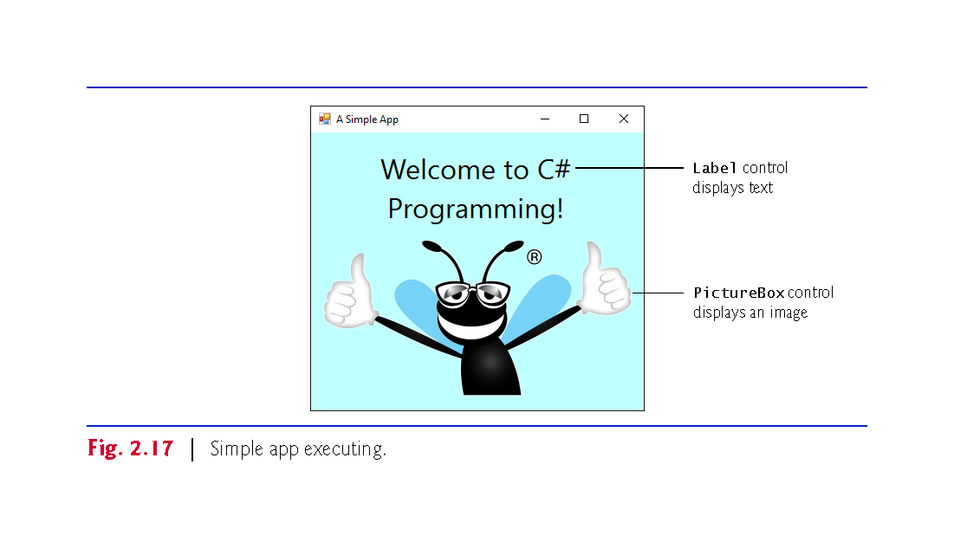

Slide 45
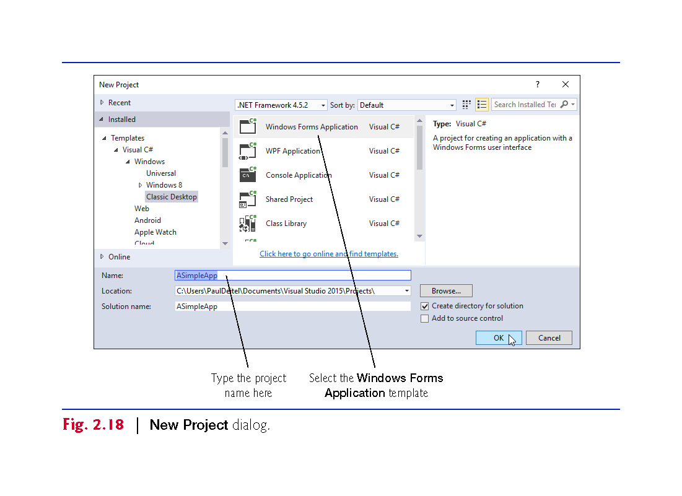

Slide 46
2.6 Visual Programming: Creating a Simple App that Displays Text and an Imag
The text in the Form’s title bar is determined by the Form’s Text property.

Slide 47
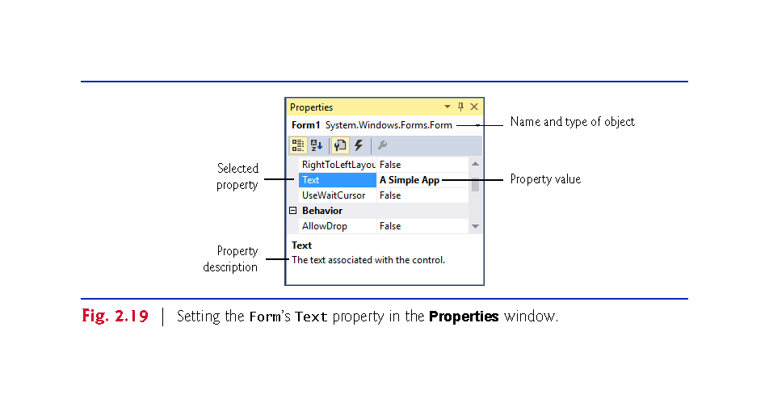

Slide 48
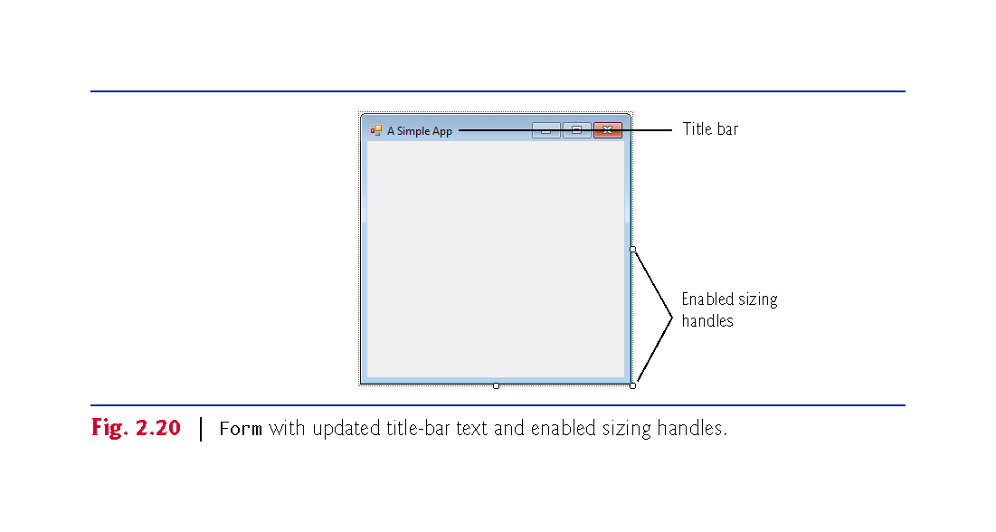

Slide 49
2.6 Visual Programming: Creating a Simple App that Displays Text and an Imag
The Form’s size is specified in pixels (that is, dots on the screen).
By default, a Form is 300 pixels wide and 300 pixels tall.
You can resize the Form by dragging one of its sizing handles (the small white squares that appear around the Form, as shown in ).
As you drag the mouse, the IDE’s status bar (at the bottom of the IDE) shows the current width and height in pixels.
You also can do this via the Form’s Size property in the Properties window.

Slide 50
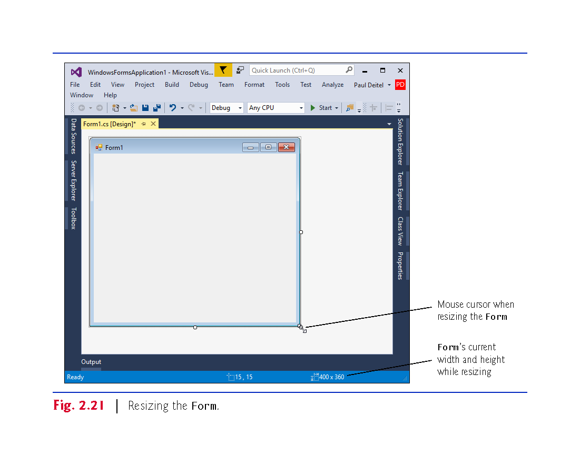

Slide 51
2.6 Visual Programming: Creating a Simple App that Displays Text and an Imag
The BackColor property specifies a Form’s or control’s background color.
Clicking BackColor in the Properties window causes a down-arrow button to appear next to the value of the property.
Clicking the down-arrow button displays other options, which vary depending on the property.

Slide 52
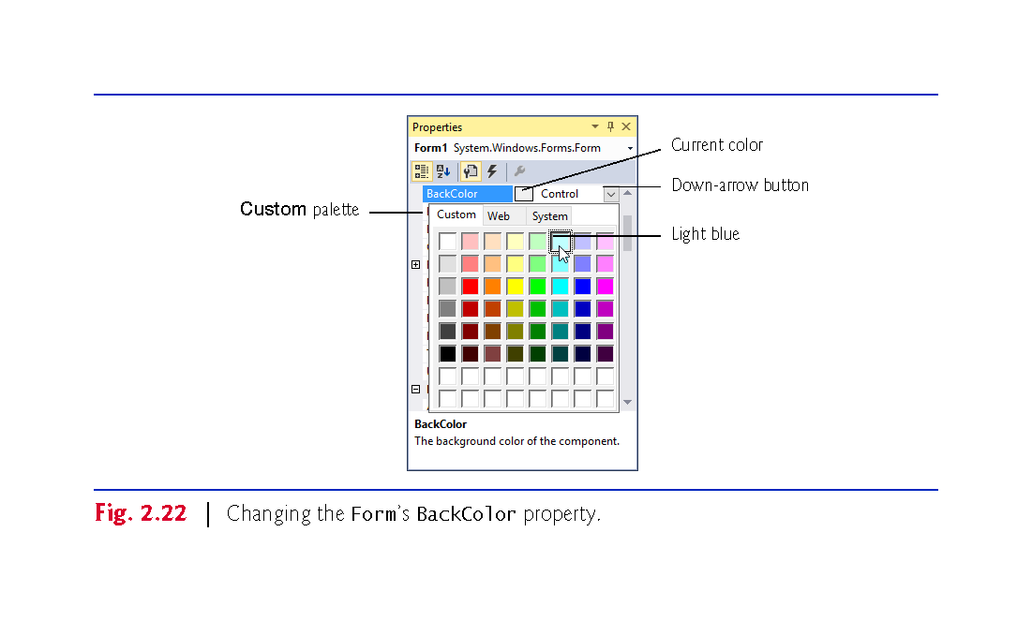

Slide 53
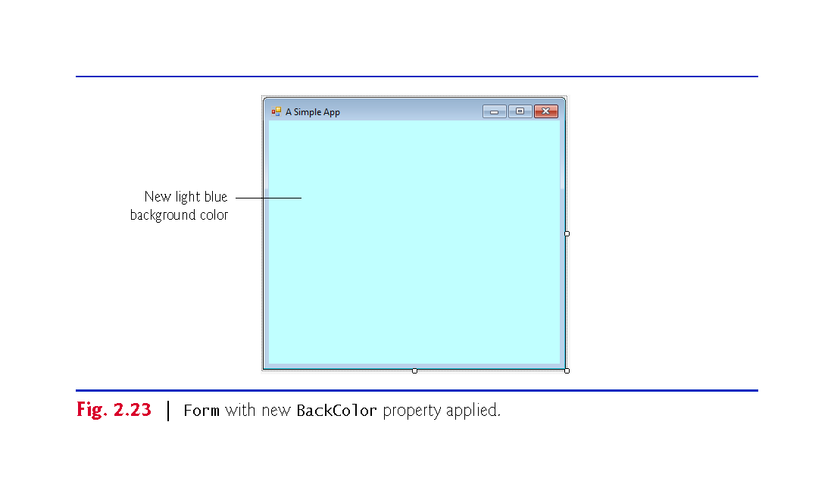

Slide 54
2.6 Visual Programming: Creating a Simple App that Displays Text and an Imag
Typical controls we use are located in the Toolbox’s Common Controls group, and also can be found in the All Windows Forms group.
Each Label you add to the Form is an object of class Label from the .NET Framework Class Library.
By default, a Label’s BackColor is the same as the Form’s.

Slide 55
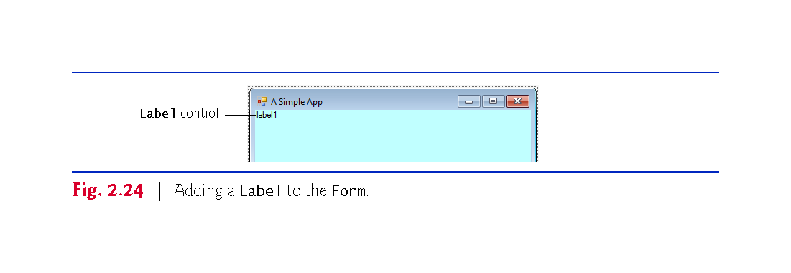

Slide 56
2.6 Visual Programming: Creating a Simple App that Displays Text and an Imag
Form and Label each have their own Text property
By default, the AutoSize property of the Label is set to True so the Label can update its own size to fit all of its text.
Setting AutoSize property to False allows you to change the Label’s size using the sizing handles.
You can center a control horizontally by selecting Format > Center In Form > Horizontally.

Slide 57
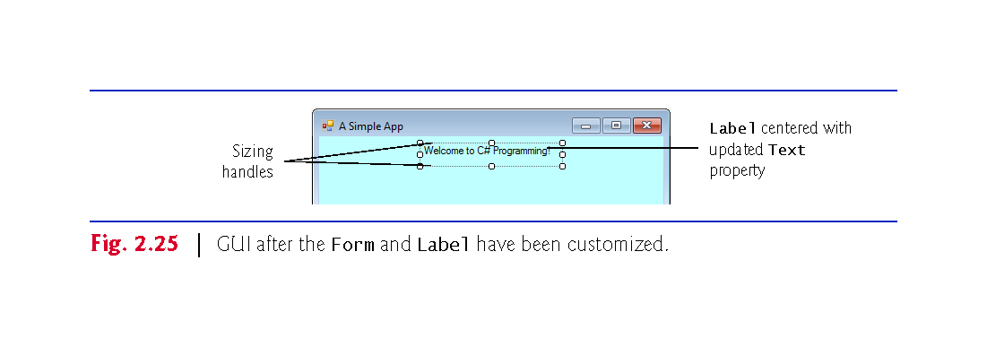

Slide 58
2.6 Visual Programming: Creating a Simple App that Displays Text and an Imag
Step 8: Setting the Label’s Font Size
Select the value of a Label’s Font property, then click the ellipsis button to display the Font dialog (Fig. 2.27).

Slide 59
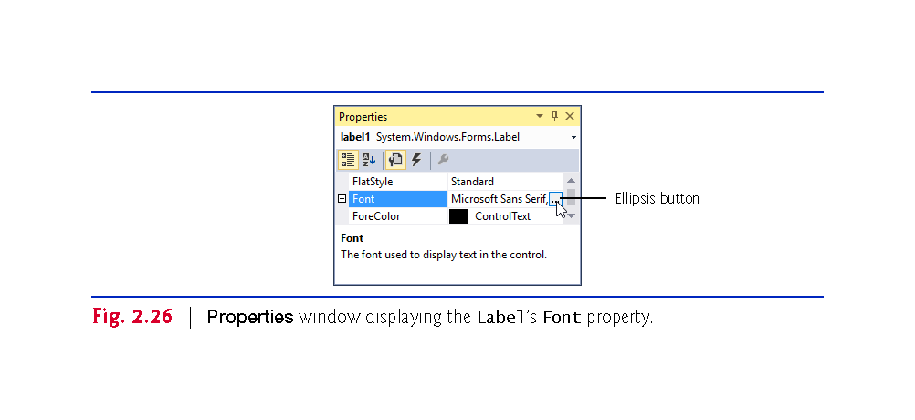

Slide 60
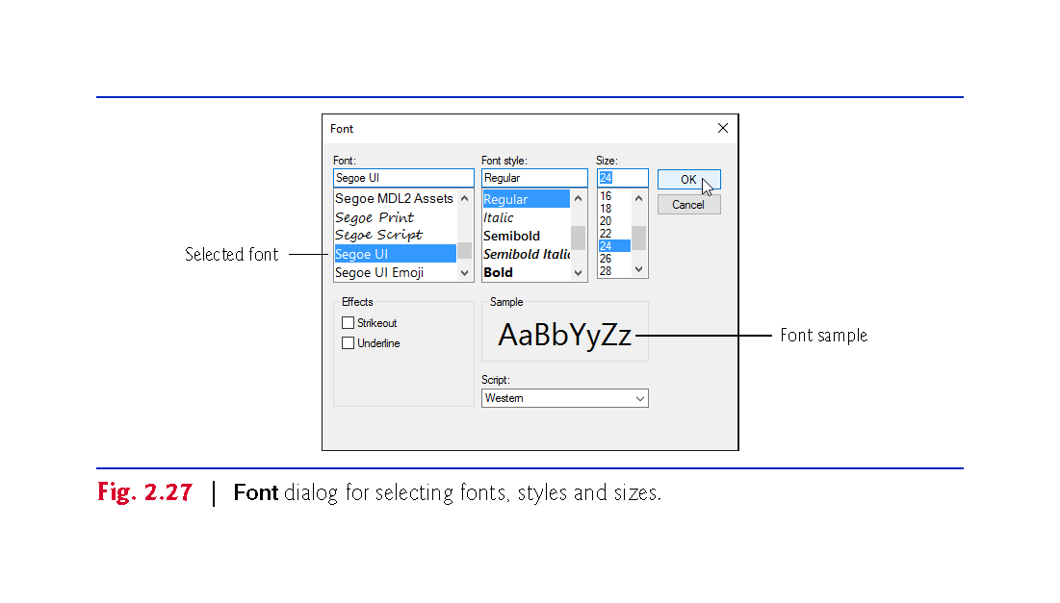

Slide 61
2.6 Visual Programming: Creating a Simple App that Displays Text and an Imag
Select the Label’s TextAlign property to display a three-by-three grid of buttons representing alignment choices.
The position of each button corresponds to where the text appears in the Label.

Slide 62
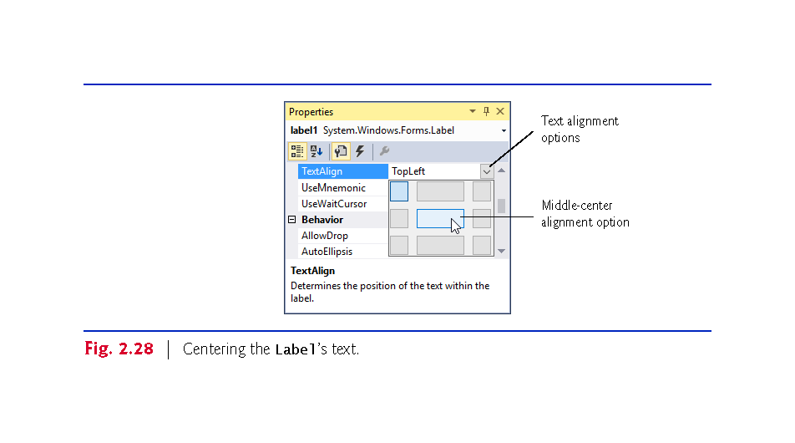

Slide 63
2.6 Visual Programming: Creating a Simple App that Displays Text and an Imag
The PictureBox control displays images.
Each PictureBox you add to the Form is an object of class PictureBox from the .NET Framework Class Library.

Slide 64
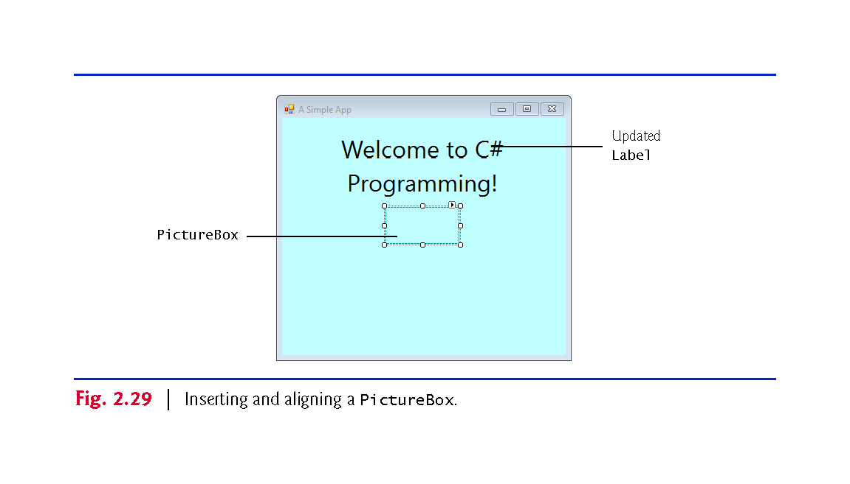

Slide 65
2.6 Visual Programming: Creating a Simple App that Displays Text and an Imag
The Image property specifies the image to display in a PictureBox.
To scale the image to fit in the PictureBox, change the SizeMode property to StretchImage.

Slide 66
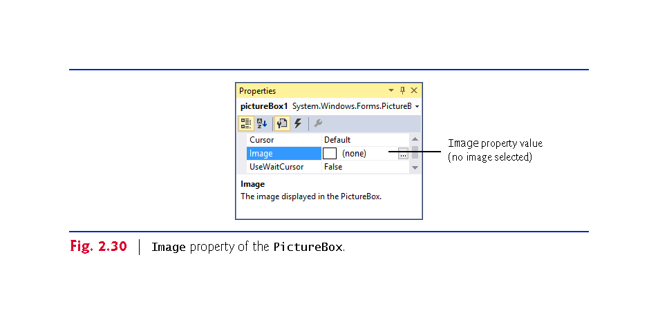

Slide 67
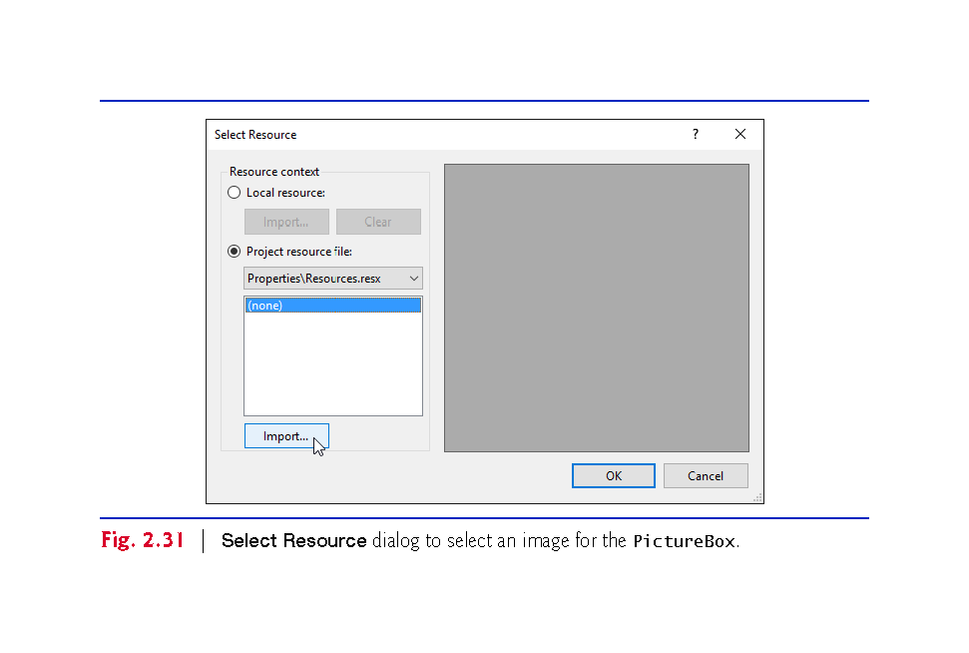

Slide 68
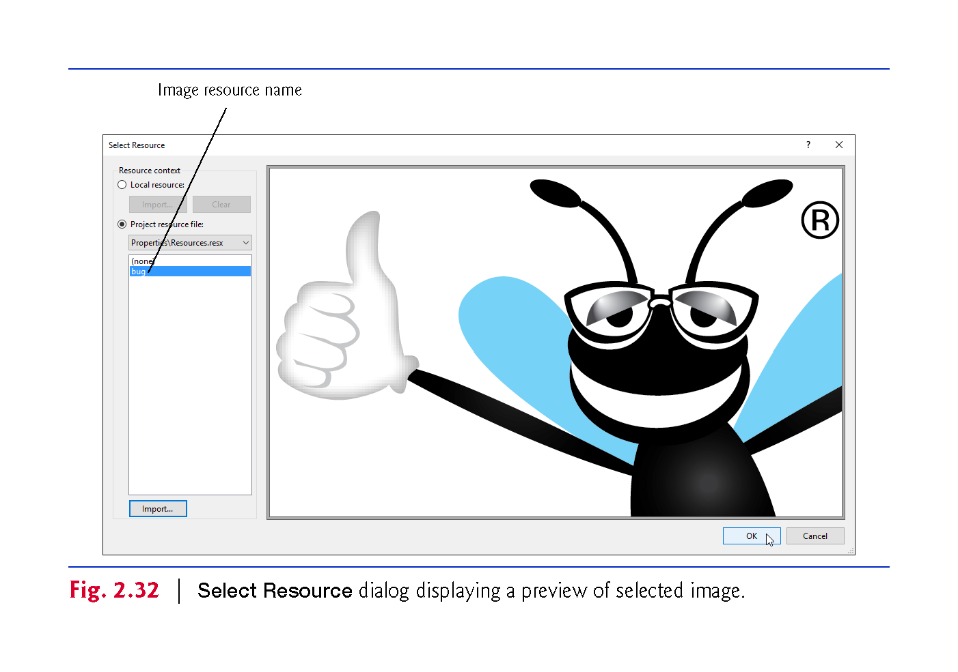

Slide 69
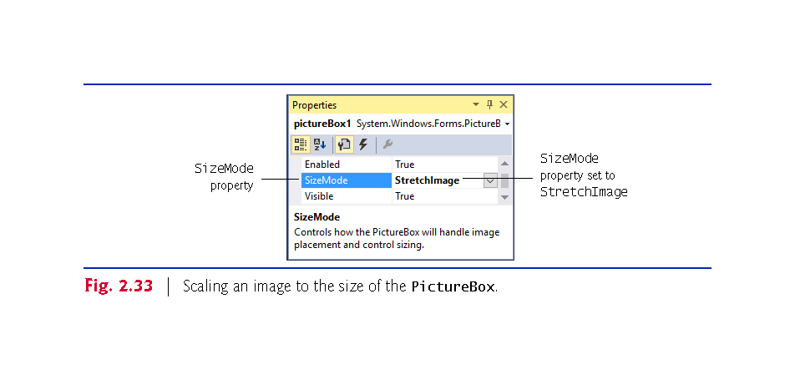

Slide 70
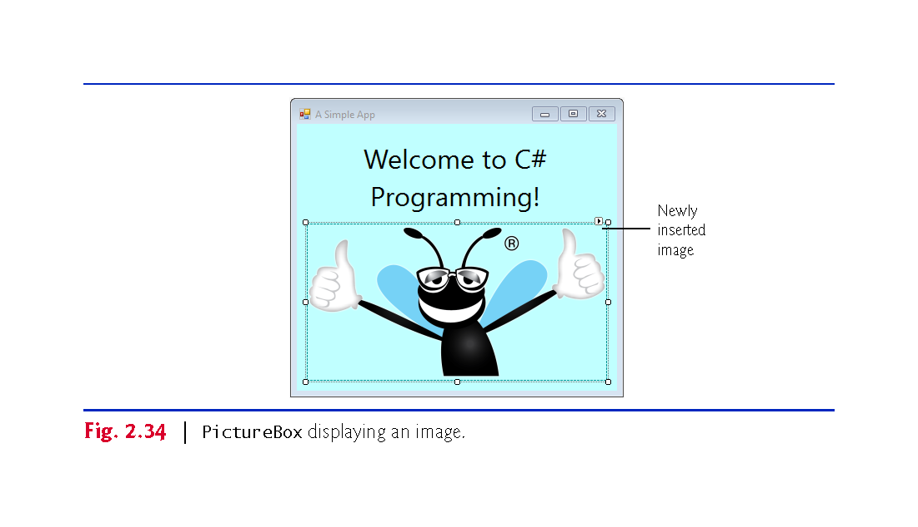

Slide 71
2.6 Visual Programming: Creating a Simple App that Displays Text and an Imag
Select File > Save All to save the entire solution.
The solution file (which has the filename extension .sln) contains the name and location of its project, and the project file (which has the filename extension .csproj) contains the names and locations of all the files in the project.
If you want to reopen your project at a later time, simply open its .sln file.

Slide 72
2.6 Visual Programming: Creating a Simple App that Displays Text and an Imag
In run mode, the app is executing, and you can interact with only a few IDE features—features that are not available are disabled (grayed out).
Select Debug > Start Debugging to execute the app (or press the F5 key).
The IDE enters run mode and displays “(Running)” next to the app’s name in the IDE’s title bar.
Click the app’s close box (X) to terminate the app

Slide 73
